Slide 1


DevOps experiences in VGT
Notes:
1

Slide 2

Mikael Sparén
Platform Area Architect
Mikael Sparén
Platform Area Architect Volvo Group Telematics Core Functions
Worked with Telematics since 2008
Previous VGT experience
Solution Architect CareTrack
Solution Architect Asia Value Truck
Solution Architect UDIS NG

Slide 3


Magnus Johansson (2)
Platform Area Buisness Analyst Volvo Group Telematics Enablers
Worked with Telematics since 2011
Previous VGT experience
Test Automation Engineer CareTrack
End-2-End Test Manager VCE
End-2-End Test Manager TISP
Team lead Cloud Infrastructure

Slide 4
History
Started in August 2015
First wave (major rollout) April-May 2016
After this two minor rollouts have happened
Rollouts target all and not just managment/team lead
Rollout to 300+ employees/consultants over 25-ish teams in the VGT organization both GOT and BLR

Slide 5
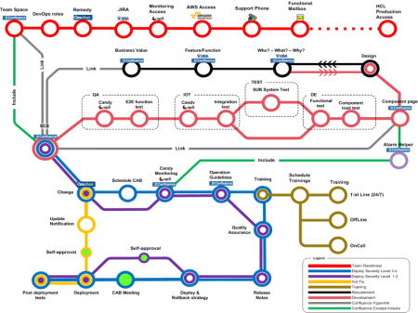
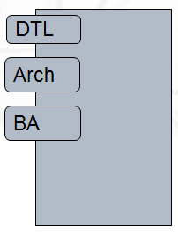
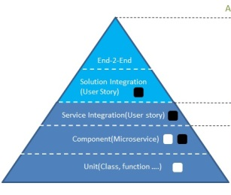


PDO WoW – Building Blocks
Rollout Strategy (Subway)
Domain Teams
Deliveries (ECS)
Test Strategy
Deployment Strategy (Delivery Engine)
Monitoring Strategy (Candy)

Slide 6
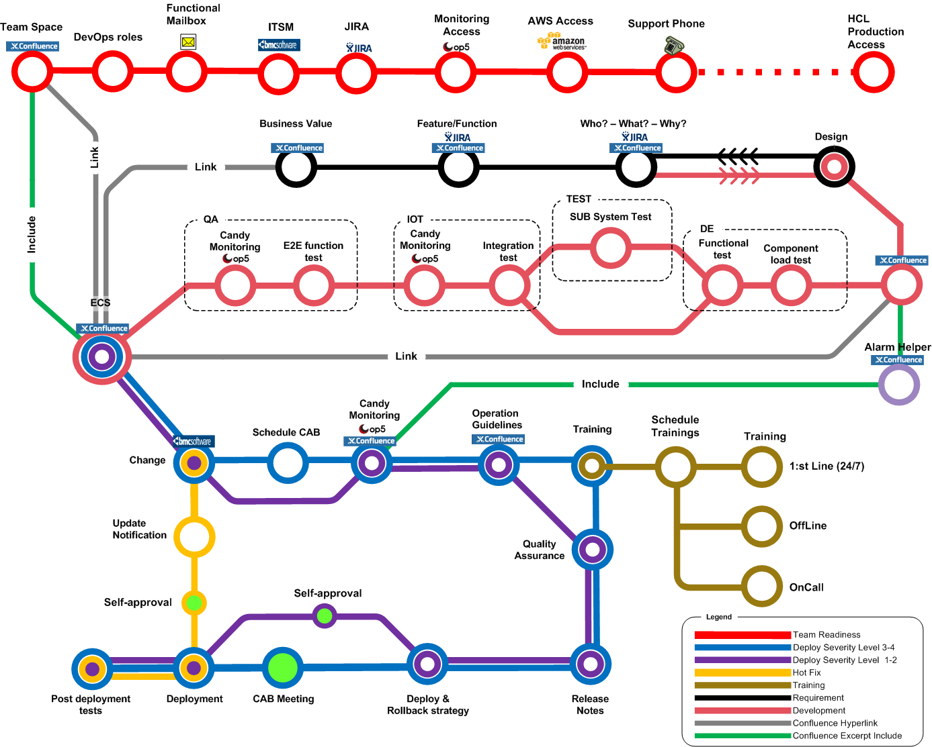
Rollout Strategy

Slide 7
Domain Teams
Self organizing
Subject matter experts in its domain
DevOps at VGT means that domain teams are taking Life-cycle ownership of their services, this includes:
Requirement - Elicit and process requirements in accordance with VGT WoW
Design - Ensure that service is aligned with VGT architecture framework.
Development - Develop in accordance with VGT development guidelines.
Quality assurance - Validate that the service will perform according to requirements.
Documentation - Provide documentation to stakeholders.
Deployment - Responsible for deployment in all environments.
Runtime monitoring - Responsible for providing runtime monitoring.
Operation responsibility - Responsible for all incidents connected to services.
Training - Make sure that training material exist and the stakeholders understand the services.

Slide 8
Exposed Component Service Responsibilities
Exposed Component Service are exposed for usage outside the responsible domain team (by a solution or by components belonging to other domain teams).
An Exposed Component Service is not only a software delivery it also includes documentation, requirement, testing , training, monitoring, lifecycle management and support.
One domain team is responsible for the entire Exposed Component Service .
The responsible domain team is the single point of contact for problems, incidents, requirements, training and support for the Exposed Component Service. If a problem or request is dependent on another service the responsibility towards stakeholders remains in the team responsible for the Exposed Component Service.
The documentation of a Exposed Component Service shall include a model of the dependencies to component services, core functions and its dataflow to applications outside the VGT Service Platform
The Exposed Component Service shall provide a service check that indicates if the entire Exposed Component Service is working.

Slide 9
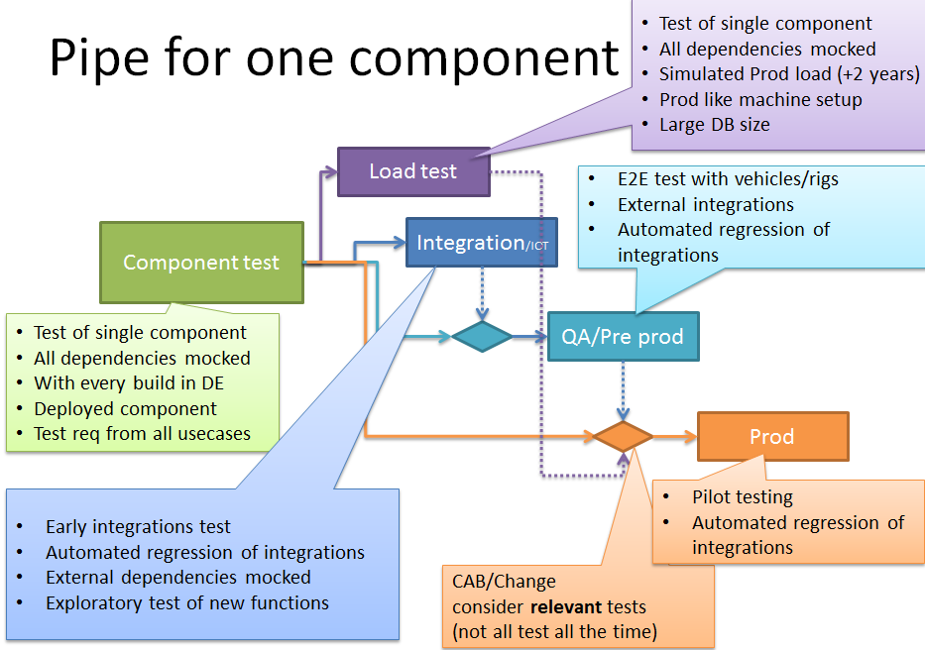
Test Strategy
Support deployment of small parts of the system
Avoiding large scale regression testing
Support Independent lifecycle of services
Component Test over integrated test
Automated quality Control

Slide 10
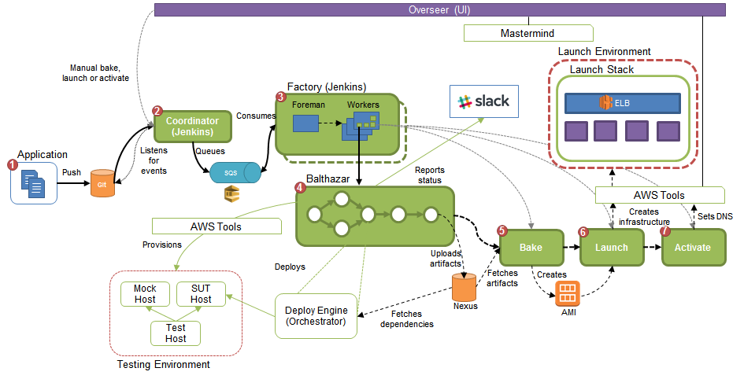
Deployment Strategy
Delivery Engine manages build and deploys for application and infrastructure
Build and deploys are version controlled, traceable
Visualize Cost follow up for cloud deployments
Creates a common abstraction layer toward Amazon API:s

Slide 11
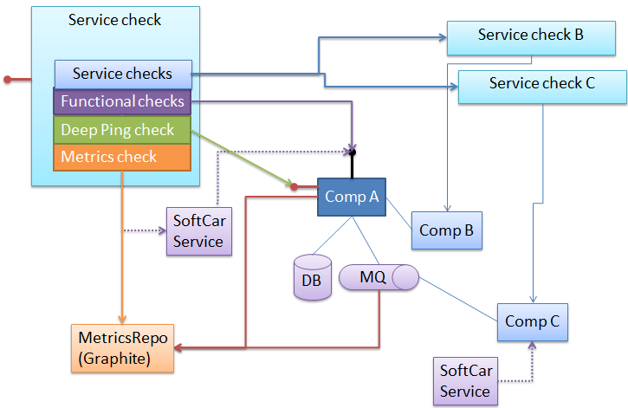
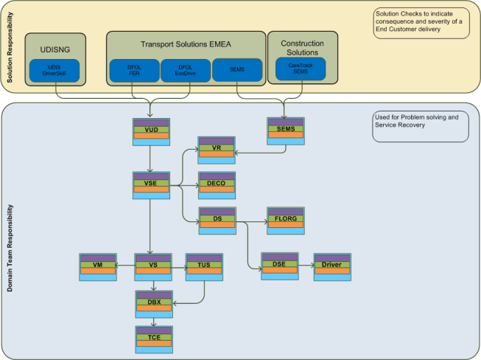
Service Monitoring
All Components/Services/Solutions provide checks. Indicating its status and failure reason.
All Checks have a corresponding Alarm Helper for problem solving.
Candy monitoring is the name for the service monitoring model which is used to ensure that the Service is available in an Integrated environment by having different layers of checks at all service levels.
Functional Checks
Deep Pings
Metrics Checks
Service Checks from dependent Services
All Services provides a Service Check to indicate if it delivers Service on a business level

Slide 12
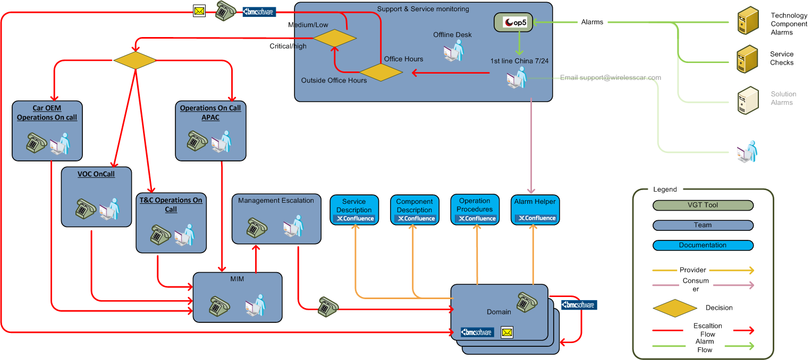
PDO Support flow

Slide 13
Lessons learned
Good:
Hands on instructions
Target all and not just managment
Work in progress
Communication between departments
Team have difficultuy to understand their deliviery in the bigger picture

